Slide 1


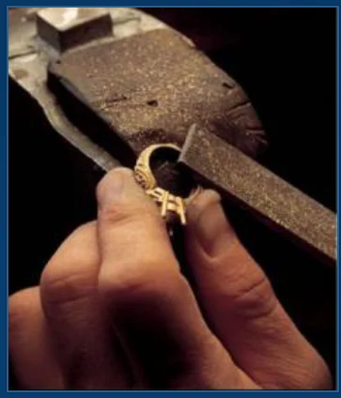
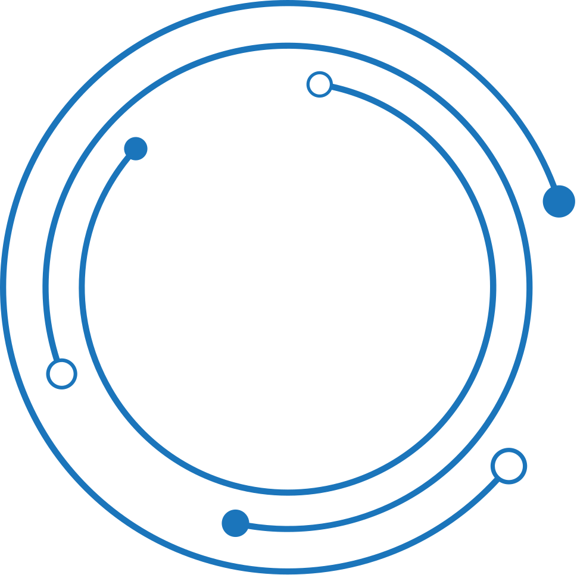
Digitize the Grinding and Polishing section of the casting industry process.

Slide 2
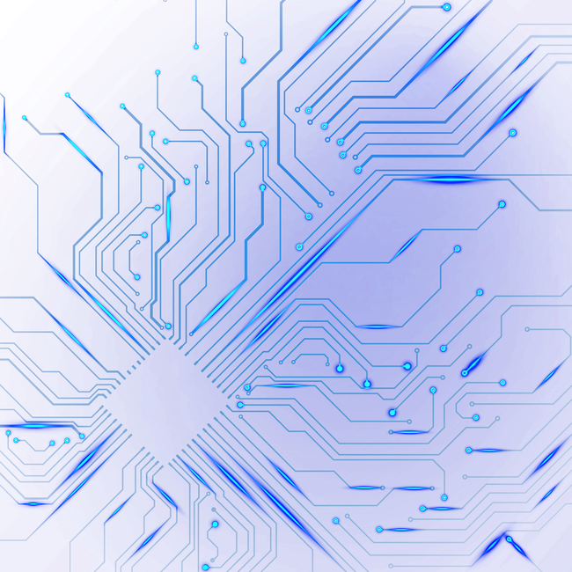

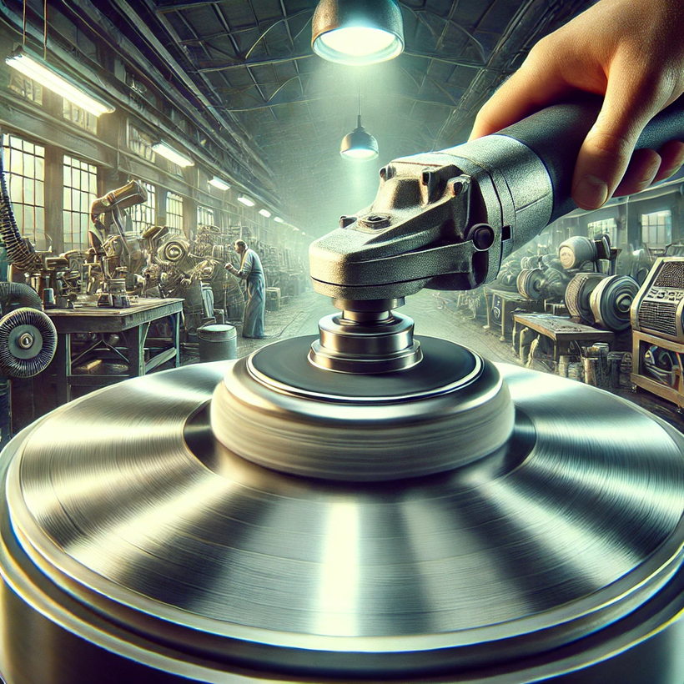
UNDERSTANDING THE PROBLEM STATEMENT
The grinding and polishing process is a crucial step in casting that transforms rough castings into finished products by removing imperfections.
This process involves multiple manual stages, where the product moves through various workstations for grinding and polishing.
The process is sequential, with each workstation focusing on a specific stage of finishing the product.
Key Challenges:
Manual Process with No Tracking: The movement of items between workstations is done manually, with no digital system to track product movement or progress.
No Worker Monitoring: There is no system to track worker presence or productivity at the stations, leading to potential delays or reduced output if a worker is absent.
02

Slide 3
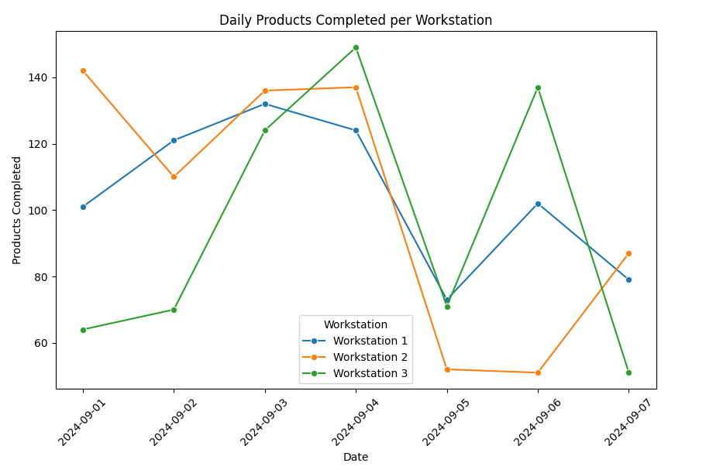
Research, Numbers, and Facts
Industry Overview:
Casting and metal finishing industries rely heavily on manual processes for grinding and polishing, creating inefficiencies.
Factories lose approximately 20-30% productivity due to untracked movements and delay.
Challenges in Manual Processes:
Manual tracking leads to delayed feedback on quality and quantity.
Unaccounted worker movement results in downtime and loss of efficiency.
Dusty environments make manual documentation difficult.
Global Stats:
The global metal finishing market was valued at $100+ billion in 2023, with polishing and grinding accounting for a significant portion.
Companies adopting digital solutions see up to a 15% increase in operational efficiency.
03

Slide 4
ASSUMPTIONS
Process Timing:
Each grinding station takes an average of 15 minutes to process one unit.
Daily target: 500 units across 3 workstations.
Workforce:
Two operators per workstation, with 3 shifts per day.
10% absenteeism rate.
Quality Control:
5% rejection rate based on quality checks after each polishing stage.
Current Manual Process Productivity:
400 completed units per day due to delays in tracking and worker movement.
04

Slide 5
PROPOSED SOLUTION: IOT AND COMPUTER VISION
Technology Solution:
IoT for Product Tracking:
Use RFID or barcode tags attached to each product for real-time tracking as it moves through the grinding and polishing stations.
Sensors at each workstation log the start and completion of each process in real-time.
Computer Vision for Worker Monitoring:
Install cameras with AI-powered video analytics to track worker presence and performance at each workstation.
Detect idle times and flag unproductive worker behavior.
Cloud Dashboard:
Visualize real-time product movement, worker activity, and overall productivity.
Alerts for delays, absenteeism, and quality issues at specific workstations.
05

Slide 6

MEASURABLE IMPACT OF THE SOLUTION
Increased Productivity:
Real-time tracking and worker monitoring can increase daily output by 15-20% (from 400 to ~480 units per day).
Enhanced Worker Accountability:
Reducing absenteeism and idle time by 10% using computer vision for tracking.
Improved Quality Control:
Immediate feedback on rejected products helps reduce the 5% rejection rate by 2-3%.
Real-time Insights:
Automated reporting and real-time dashboards eliminate the need for manual reconciliation, improving decision-making speed.
06

Slide 7

CONCEPT DASHBOARD & REPORTS
Dashboard Overview:
Workstation Status: Displays real-time status of each workstation, product count, and active workers.
Product Flow: Visualize the flow of products across stages (Grinding 1, Grinding 2, Polishing).
Worker Metrics: Tracks worker activity, time spent at each station, and absenteeism rates.
Quality Insights: Shows rejection rates, reasons for failure, and stage-wise breakdown.
Reports:
Daily, weekly, and monthly productivity reports.
Worker performance analytics.
Quality control trends and areas for improvement.
07

Slide 8
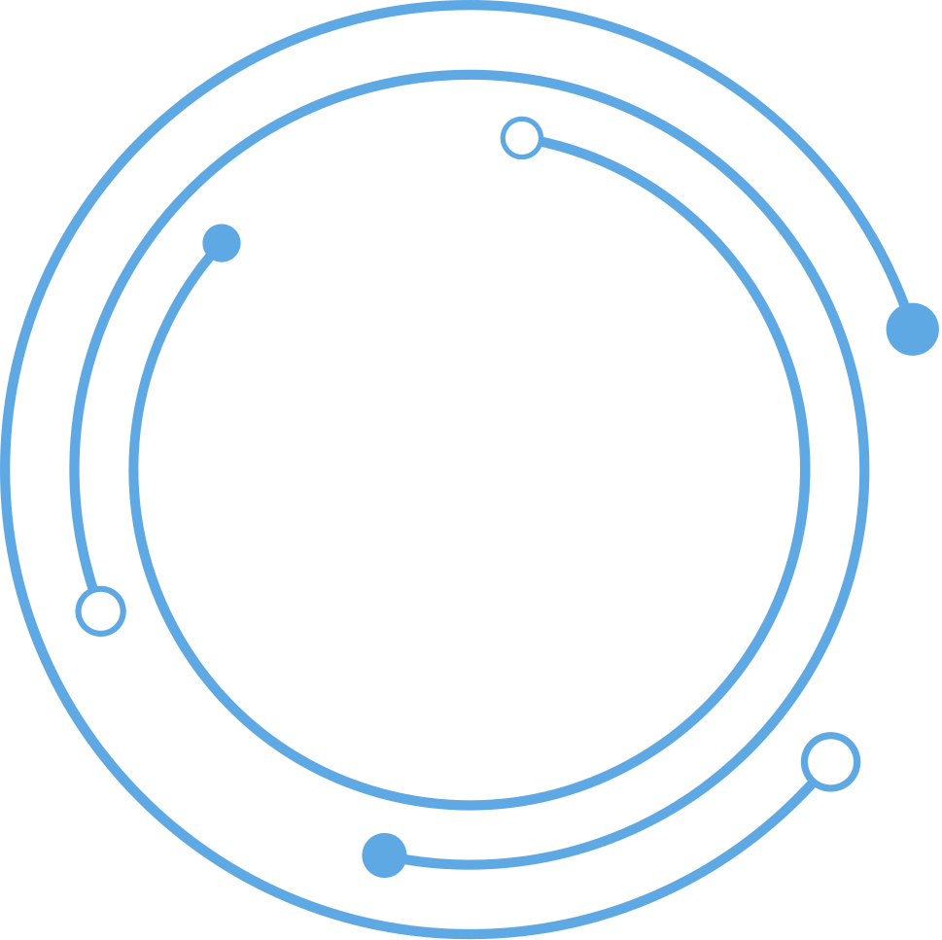
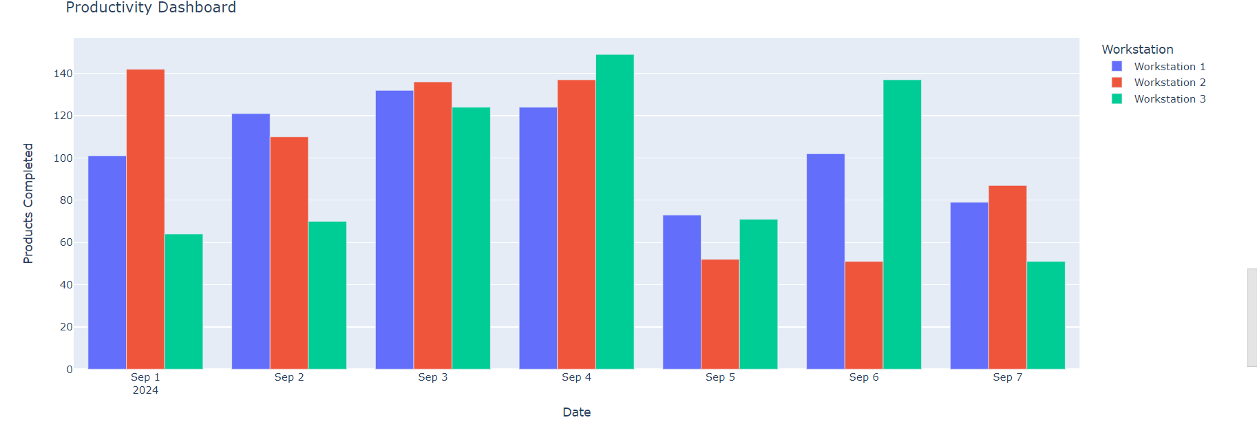
PRODUCTIVITY DASHBOARD
08

Slide 9
Thank you

